Slide 1
Physical Education in the Modern Era: Issues and Future Directions
Associated Prof. Dr. Renata Rutkauskaite
renata.rutkauskaite@lsu.lt

Slide 2
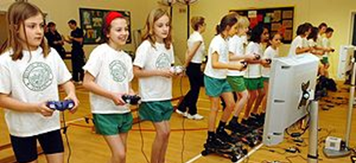
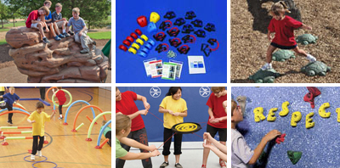
Index
Introduction: The Evolution of Education and Physical Education
Current Issues in Physical Education
Integrating Technology
Inclusivity and Accessibility
Budget Constraints and Resource Limitations
Remote Learning Challenges
Promoting Mental Health
Creating indoor and outdoor affordances
Conclusions

Slide 3
Notes:
The evolution of education has been a dynamic process, shaped by social, technological, and cultural changes over centuries.
From carving on stone tablets to swiping on tablets, education has come a long way, but students still think homework is set in stone!
From learning under trees to virtual classrooms in cyberspace, education has evolved so much that even the School of Athens might now offer online courses!

Slide 4
Learner agency: Navigating through a complex and uncertain world
Figure 1. The OECD Learning Framework 2030: Work-in-progress
Notes:
Figure shows some of the relationships between the various terms associated with learning, knowledge and skills are intertwined as if in a strand of learning produce competencies which in turn appear to provide the necessary support for a
learner to navigate his or her way through uncertain times with the help of those around.
Therefore, In practice, 21st-century education requires rethinking the roles of teachers, students, and educational institutions. It also involves redesigning learning spaces to accommodate new modes of learning, such as flipped classrooms and blended learning environments. Moreover, it acknowledges the importance of soft skills alongside hard skills, ensuring students are prepared for a diverse and changing world.

Slide 5
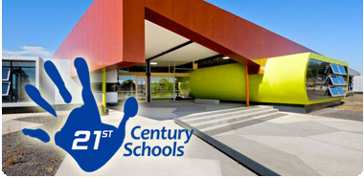
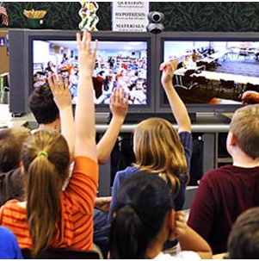
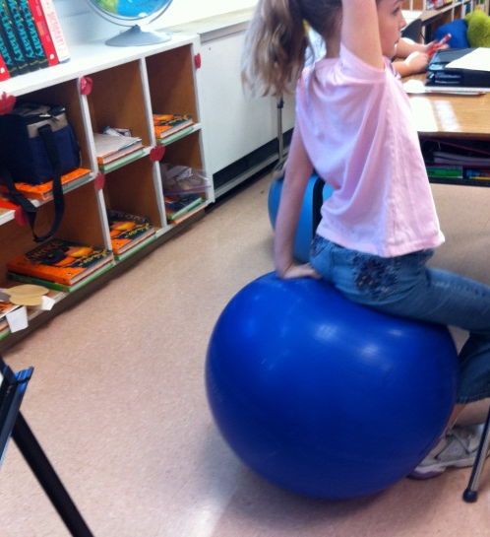
21st century schools
A twenty-first century skill is - a skill that is considered new and especially important in today's world, often meaning digital communication.
Notes:
Education in the 21st century is an evolving concept that reflects the rapid changes in technology, society, and the job market.
Several key aspects that define 21st-century education:
Technology Integration: Embracing technology to enhance learning, including the use of computers, tablets, and the internet as educational tools.
Student-Centered Learning: Shifting from traditional teacher-centered instruction to methods that are student-centered, focusing on the interests and needs of the students.
Critical Thinking and Problem-Solving: Encouraging students to think critically and solve complex problems rather than just memorizing facts.
Collaboration and Communication: Promoting teamwork and communication skills, which are vital in a globalized world.
Personalized Learning: Customizing education to suit individual student strengths, needs, interests, and skills through adaptive learning technologies and flexible curriculums.
Global Awareness: Preparing students to work in an international context, including the study of foreign languages, cultures, and global issues.
Information Literacy: Teaching students how to find, evaluate, and use information effectively, especially in the age of information overload.
Lifelong Learning: Instilling the importance of continuous education and the pursuit of knowledge throughout one's life.
Interdisciplinary Teaching: Integrating multiple subjects into learning projects to reflect the interconnectedness of different areas of knowledge.
Ethical and Social Impact: Including ethical and social responsibility as a part of the curriculum to develop citizens who can contribute positively to society.
Creativity and Innovation: Encouraging creativity and innovation, recognizing that new ideas are essential for advancement.
Environmental Education: Incorporating sustainability and environmental stewardship into the curriculum to foster an understanding of ecological concerns.

Slide 6
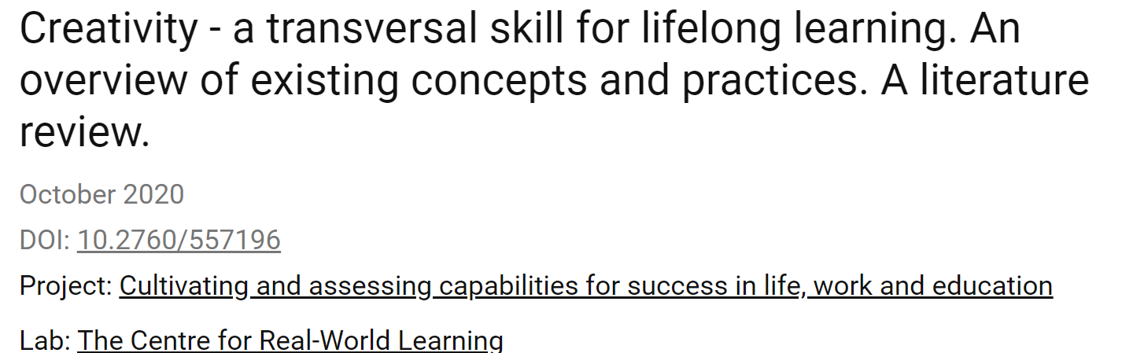
Creativity - is an essential skill for lifelong learning Non-traditionality - is a skill that helps you constantly adapt
NB !!!
Transferable skills – skills which is relevant or essential in 2023, will necessarily be relevant in 2080 given a rapidly changing world.
Notes:
Twenty-first century skill – a skill deemed to be somehow new and of particular relevance in today’s world, often implying a digital connection. Often meaning much the same as transversal skills or competences or transferable skills, is undermined by the unbelievable notion that a skill which is relevant or essential in 2023 will necessarily be relevant in 2080 given a rapidly changing world.

Slide 7
Index
Introduction: The Evolution of Education and Physical Education
Current Issues in Physical Education
Integrating Technology
Inclusivity and Accessibility
Budget Constraints and Resource Limitations
Remote Learning Challenges
Promoting Mental Health
Creating indoor and outdoor affordances
Conclusions

Slide 8
Index
Introduction: The Evolution of Education and Physical Education
Current Issues in Physical Education
Integrating Technology
Inclusivity and Accessibility
Budget Constraints and Resource Limitations
Remote Learning Challenges
Promoting Mental Health
Creating indoor and outdoor affordances
Conclusions

Slide 9
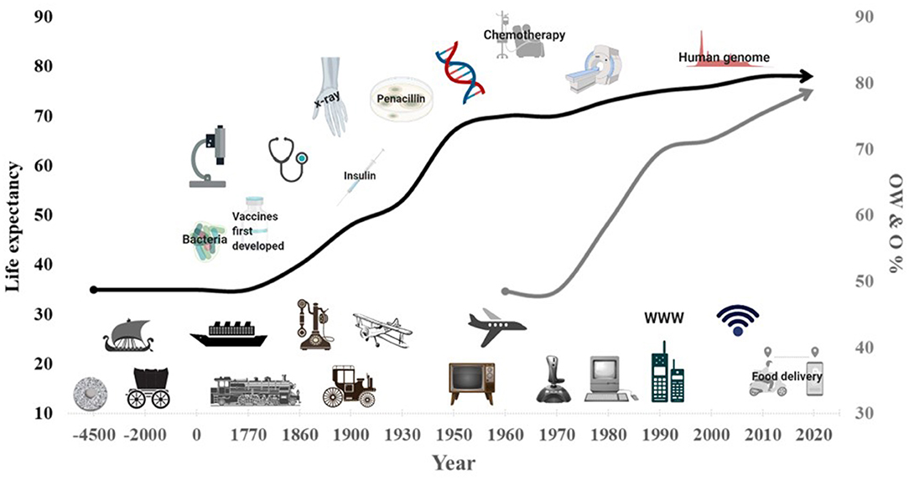
DEVELOPMENT OF TECHNOLOGY ENCOURAGES PHYSICAL INACTIVITY...
Woessner et al. (2021) The Evolution of Technology and Physical Inactivity: The Good, the Bad, and the Way Forward. Front. Public Health 9:655491.
Increased life expectancy (black line) and trends in overweight and obesity (OW and O, gray line) due to advanced technology and medical treatment
Notes:
In this figure you can see increased life expectancy (black line) and trends in overweight and obesity (OW and O, gray line) due to advanced technology and medical treatment
Human inventions to make work and life less physically demanding began about six or seven thousand years ago with the invention of the wheel and the horse or cattle-drawn carriage. These inventions not only saved people from the "effort" of walking, carrying and lifting, but also ushered in a new era of commerce and inspired new modes of transportation. These new ideas materialized during the Industrial Revolution (1750–1914), which led to new possibilities for transportation by land, sea, and air. Advances in business technology improved work efficiency and profits while reducing the amount of manual labor required, but the second half of the 20th century, and especially after the 1970s, saw the onset of the "electronics and telecommunications revolution”.

Slide 10
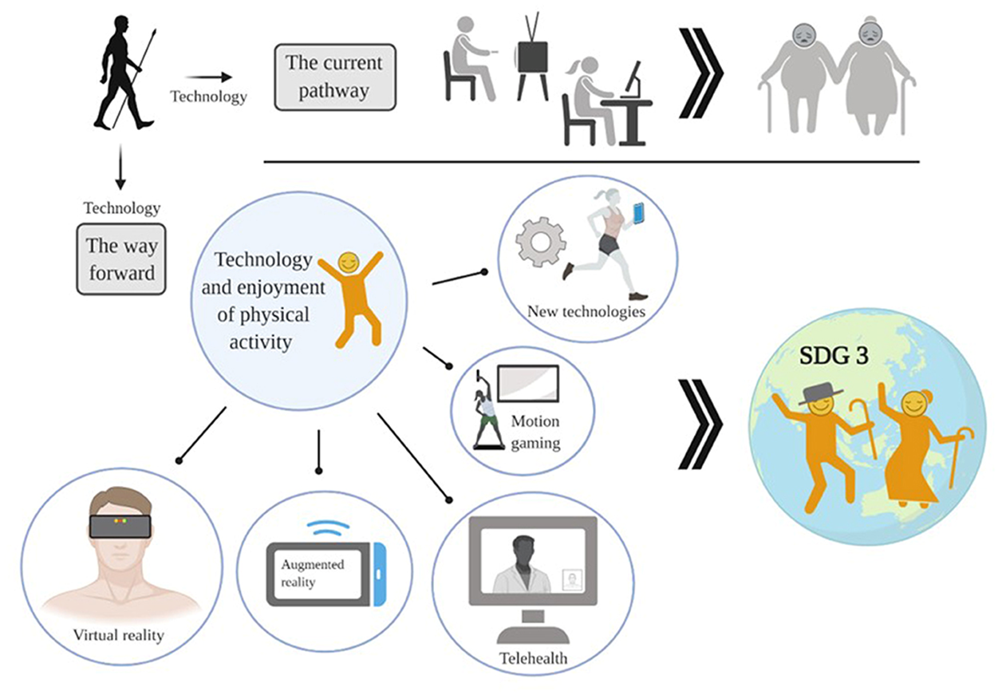
Technology leads to inactivity, but it can also help you be active!
Woessner et al. (2021) The Evolution of Technology and Physical Inactivity: The Good, the Bad, and the Way Forward. Front. Public Health
Currently, technology promotes sedentary lifestyles and physical inactivity, but technology has enormous potential to use it to promote greater engagement and enjoyment of physical activity. It contributes to UN SDG no. 3 goals and indicators, ensuring health and well-being for all.
Notes:
Technology leads to inactivity, but it can also help you be active!
Currently, technology promotes sedentary lifestyles and physical inactivity, but technology has enormous potential to use it to promote greater engagement and enjoyment of physical activity. It contributes to UN SDG no. 3 goals and indicators, ensuring health and well-being for all.

Slide 11
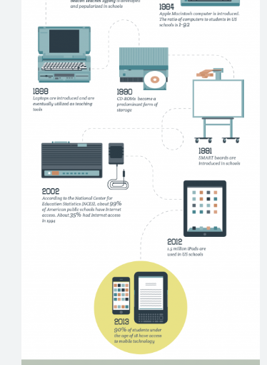
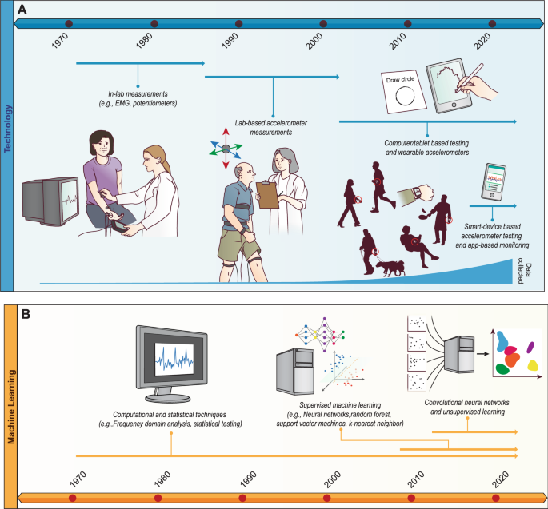
ICT APPLICATIONS IN EDUCATION
Started with the use of the desktop PC in 1996~;
followed by e-learning in 2003~ using the Internet PC,
afterwar m-learning in 2005~ using the Notebook and PDA (Personal Digital Assistant),
with later upcoming u-learning in 2010 using smartphones.
The year 2012 was the start of the era of Smart Education, with the use of several devices in education,
Use of virtual or augmented reality.
(Kitowski et al., 2015; Rutkauskaite et al., 2022).

Slide 12
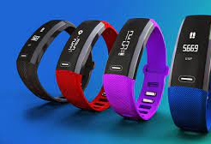
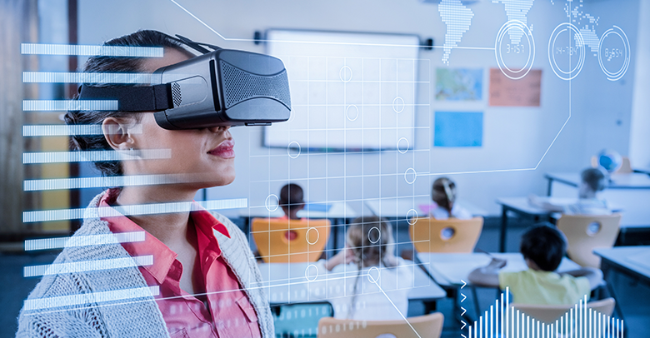
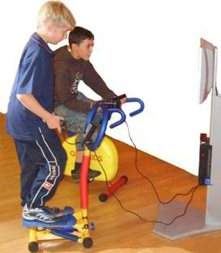
ICT equipment at the national level;
to up-date the educational content;
to prepare computer-based methodological materials and
to invest in teachers’ abilities and knowledge in this area
Notes:
Technology integration, while beneficial, also brings challenges. For example, while fitness trackers can motivate students, over-reliance on them might overshadow fundamental physical skills. Teachers next to pedagogical and content knowledge need to have technological knowledge and skills, which in addition is time consuming factor.
ICT equipment at the national level;
to up-date the educational content;
to prepare computer-based methodological materials and
to invest in teachers’ abilities and knowledge in this area

Slide 13
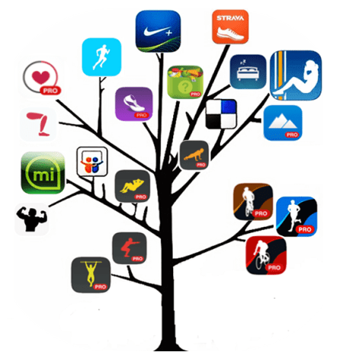
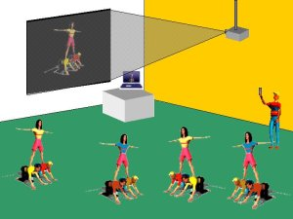
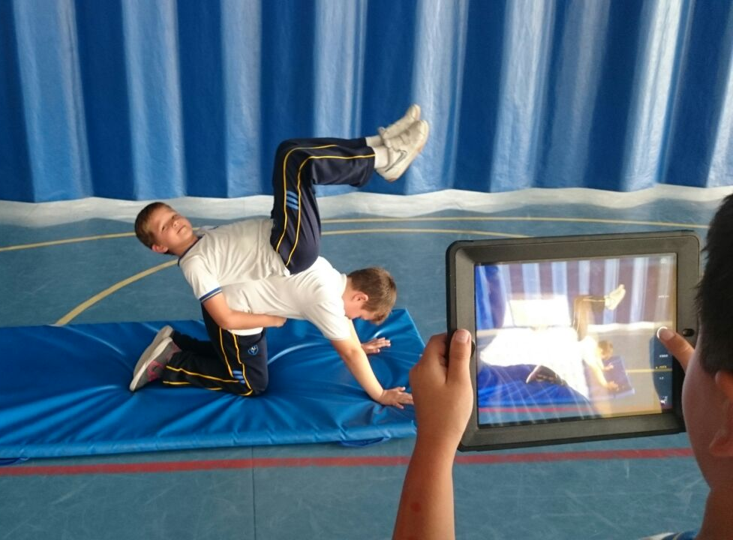
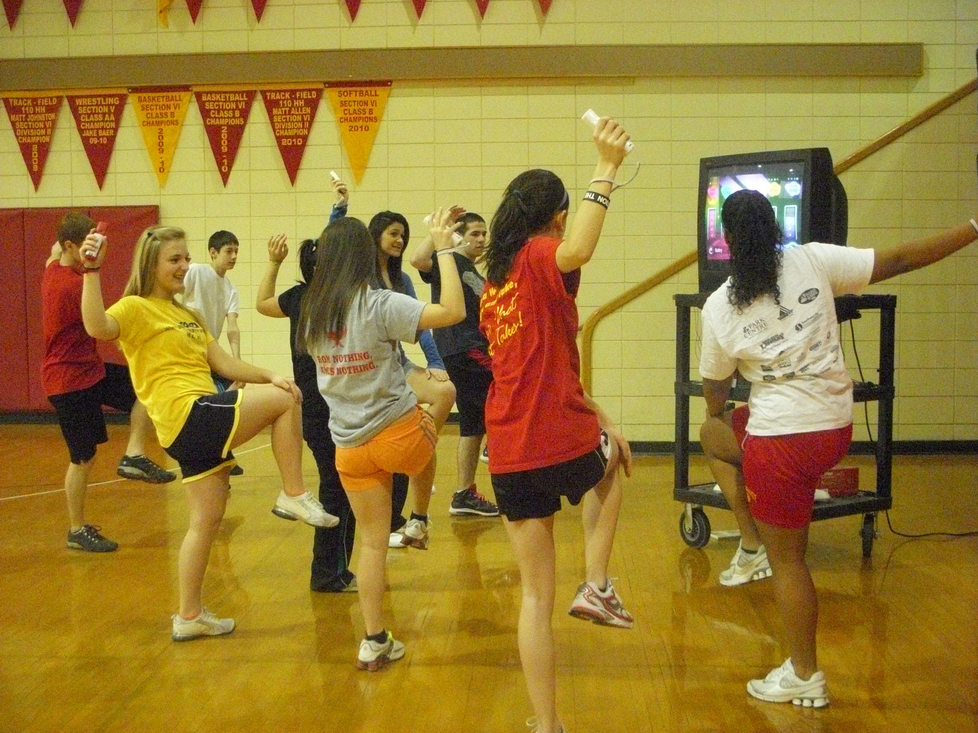
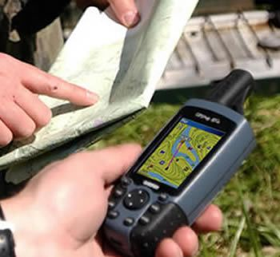
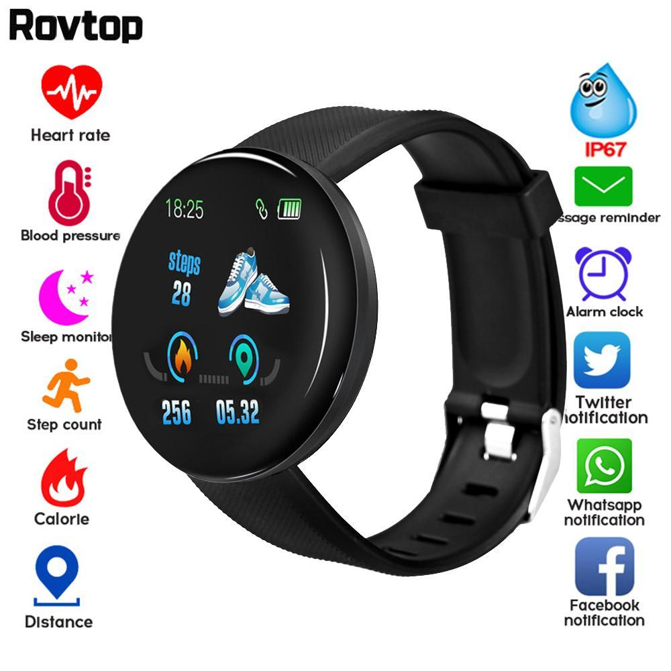
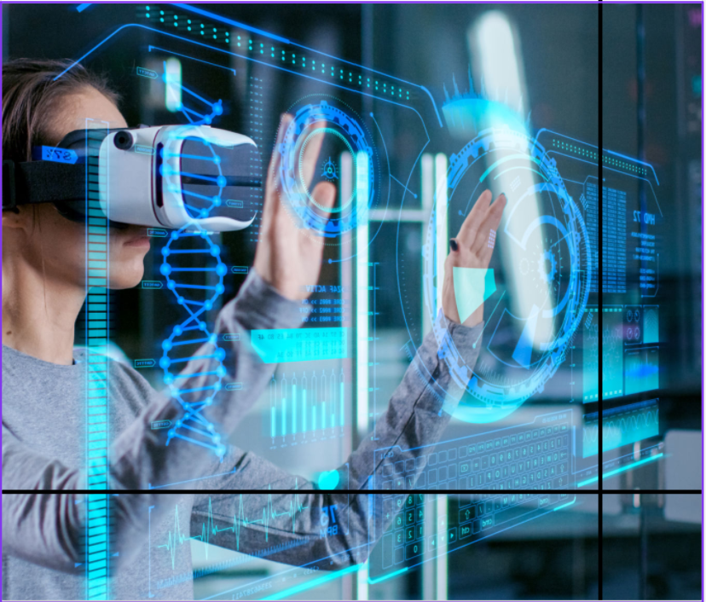
Technologies in physical education
Video analysis software
Mobile applications
Online photos and videos
Virtual classes
Gaming systems
Monitors and tracking devices
Smart watches
Virtual and augmented reality
(Suriya et al., 2020)
Notes:
Video Conferencing: This technology allows individuals to communicate in real-time via audio and video, allowing for remote guidance and assistance. Examples of video conferencing platforms include Zoom, Skype, and Google Meet.
Remote Monitoring: This technology allows remote monitoring of a person's performance, providing data and feedback for improvement.
Augmented and Virtual Reality: These technologies can be used to create immersive remote instruction experiences that allow individuals to practice and receive feedback in a simulated environment.
Mobile Apps: Mobile apps can be used to provide advice and support through a user-friendly interface on a smartphone or tablet mobile phone.
Wearable devices: Wearable devices such as smart watches and fitness trackers can be used to track and monitor an individual's progress and provide real-time feedback.
13

Slide 14
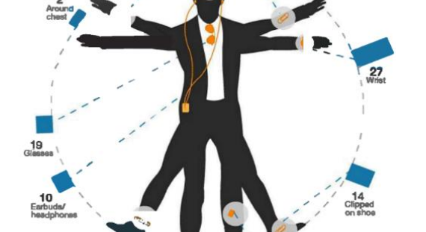
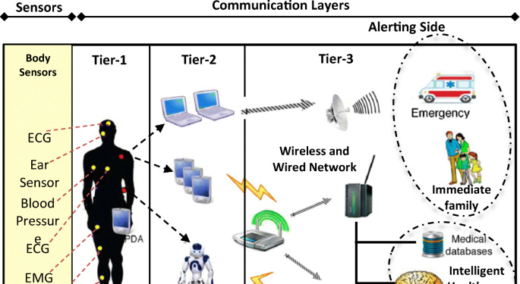
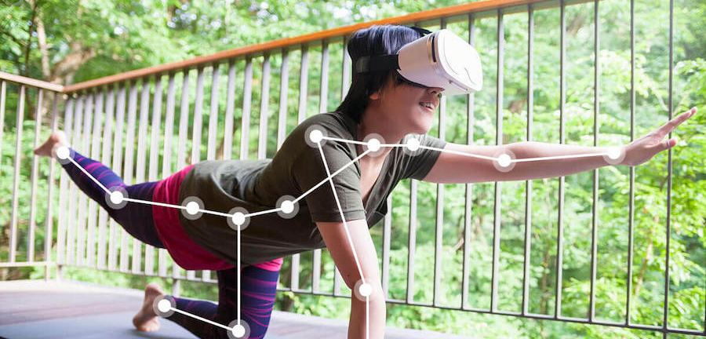
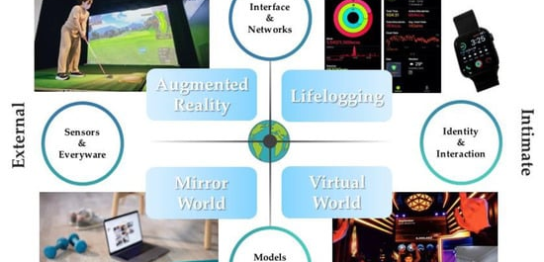
Notes:
Looking ahead, imagine PE with virtual reality. One day you're learning to ski in the Alps, the next you're swimming with dolphins – all without leaving the gym. And let’s not forget mental health – starting classes with mindfulness might just be the warm-up we all need to avoid pulling a mental muscle!

Slide 15
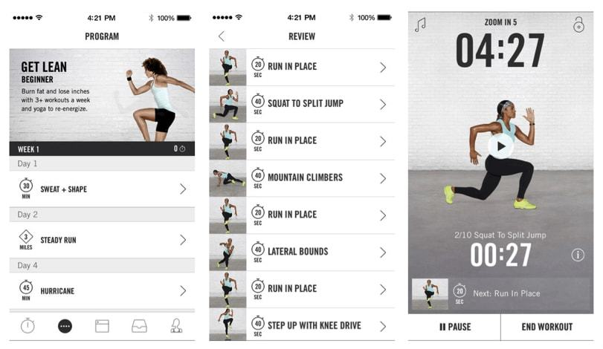
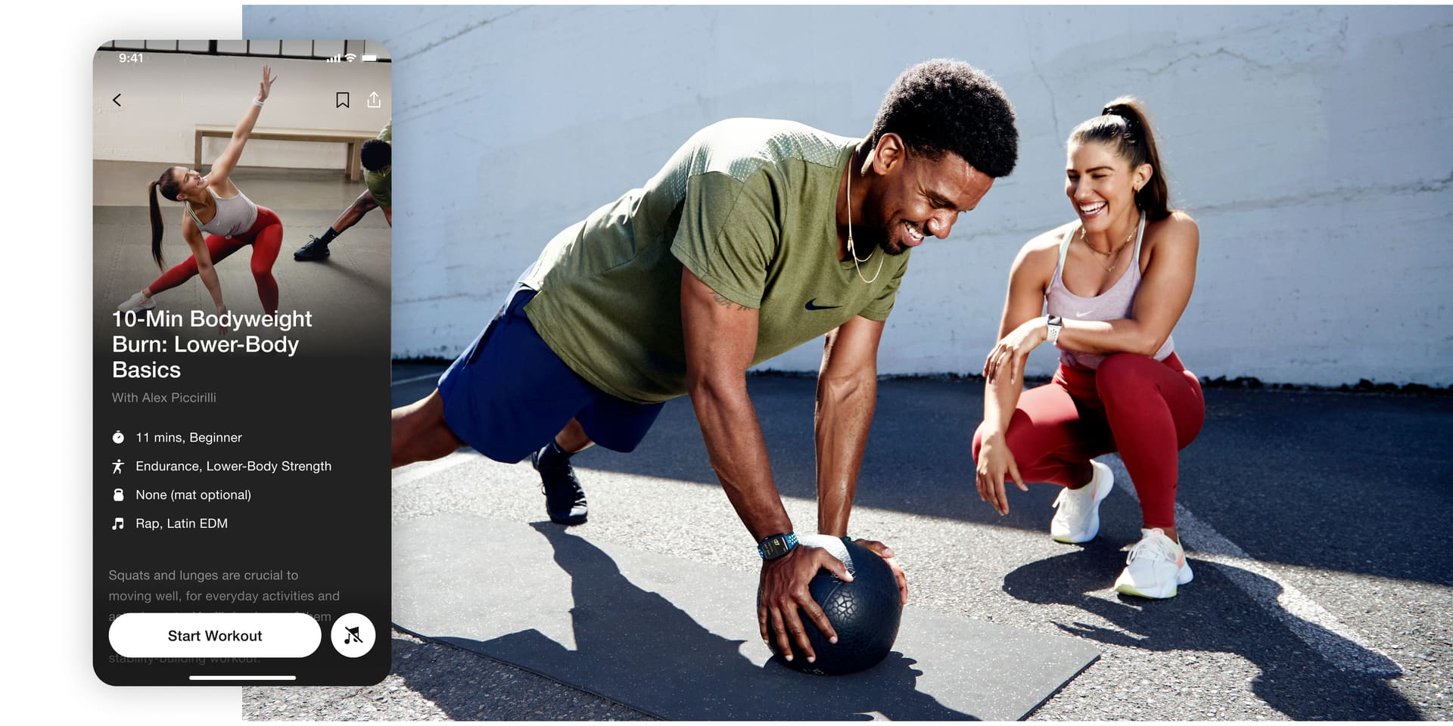
Appropriate smart applications and web platforms in Sports training
Nike Training Club: A fitness app that provides users with personalized workout plans, video demonstrations of exercises, and the ability to track their progress.
Notes:
Adamakis, Manolis. (2017). Nike+ Training Club, an ultimate personal trainer: mobile app user guide. British Journal of Sports Medicine. Online first. 10.1136/bjsports-2017-098414.

Slide 16
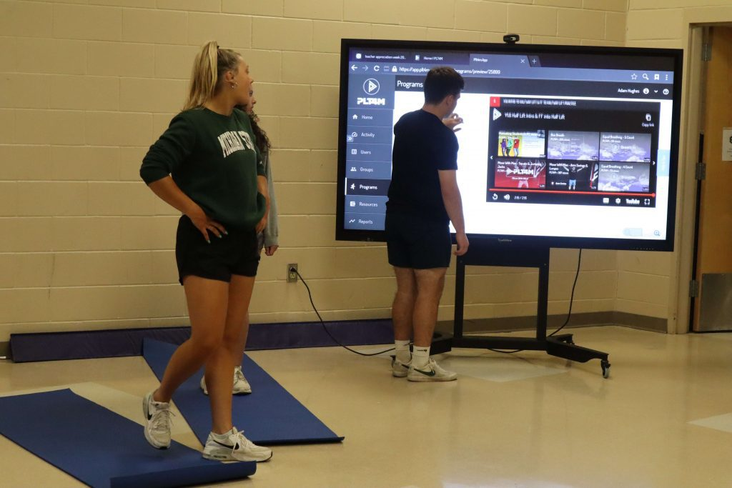
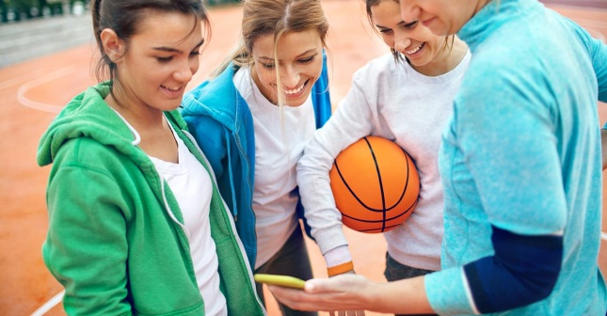
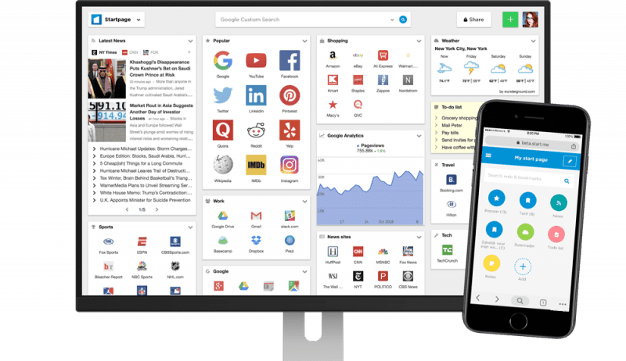
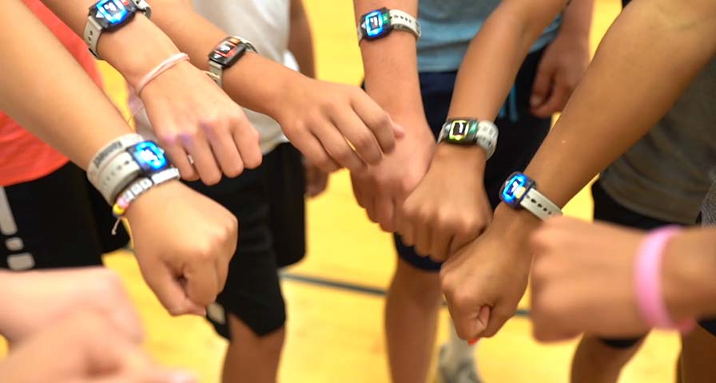
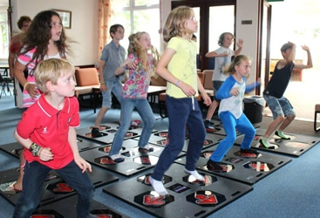
Embracing Technology Innovatively
Pedometers and Heart Rate Monitors
Health Tracking Technology
Mobile App Technology
Video-Sharing Websites
Gaming Technology
Virtual Classrooms
Smartwatches
Notes:
Embracing technology innovatively in physical education (PE) has opened new avenues for enhancing student engagement, tracking progress, and diversifying the types of activities that can be included in a PE curriculum. Here are some practical examples of how technology is being integrated into PE:
Pedometers and Heart Rate Monitors:
Pedometers: These devices measure steps and can be used for a variety of activities, including household chores or scavenger hunts. They are adaptable for different age groups and ability levels, making them an inclusive tool in PE​​.
Heart Rate Monitors: These help measure a student's pulse during activities, allowing for individualized target heart rates that are challenging but achievable. They empower students to monitor and understand their own fitness levels, contributing to personalized fitness goals​​.
Health Tracking Technology:
Integration with Devices: Many pedometers and heart monitors come with connectivity options, which aid in creating long-term health plans. The data collected can be used to set custom goals, and students receive instant feedback, helping them adjust their goals and strategies accordingly​​.
Mobile App Technology: Fitness and Health Apps: Apps like MapMyFitness and MyFitnessPal offer movement tracking and nutritional help. They allow students to track their own activities and dietary habits, providing an integrated approach to health and fitness​​.
Performance Analysis Apps: Apps like Coach's Eye offer slow-motion video playback, instantaneous sharing, and offline viewing capabilities, giving students detailed insights into their performance​​.
Video-Sharing Websites:
Educational Content: Platforms like YouTube and Vimeo offer a range of instructional videos in sports, fitness, and health education. These resources can be used to demonstrate activities or to provide theoretical knowledge​​.
Gaming Technology: Exergames: Games like Dance Dance Revolution or Wii Sports integrate physical activity into gaming. These games get students moving through enjoyable and interactive experiences​​​​.
Virtual Classrooms: Online Learning Platforms: Video chat programs and blogging platforms have been utilized for virtual PE classes, allowing teachers and students to connect and interact with PE content from any location​​.
Smartwatches:
Advanced Tracking: Smartwatches offer comprehensive health and wellness tracking, including exercise, sleep patterns, mood, and more. They provide a modern approach to monitoring and encouraging physical activity among students​​.
These innovative uses of technology in PE not only make physical education more accessible and engaging but also help in tracking and improving students’ health and fitness levels in a more personalized and interactive manner. The integration of technology in PE represents a significant advancement in how physical education is taught and experienced in modern educational settings.

Slide 17
Index
Introduction: The Evolution of Education and Physical Education
Current Issues in Physical Education
Integrating Technology
Inclusivity and Accessibility
Budget Constraints and Resource Limitations
Remote Learning Challenges
Promoting Mental Health
Creating indoor and outdoor affordances
Conclusions

Slide 18
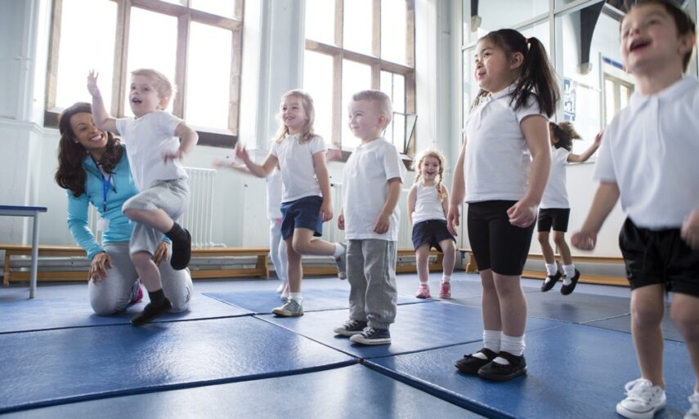
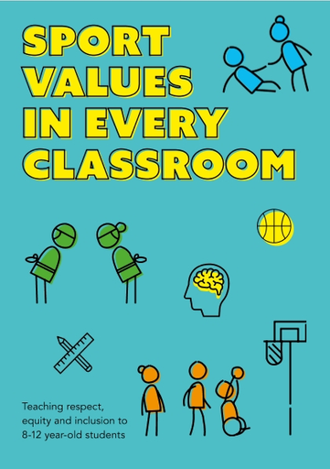
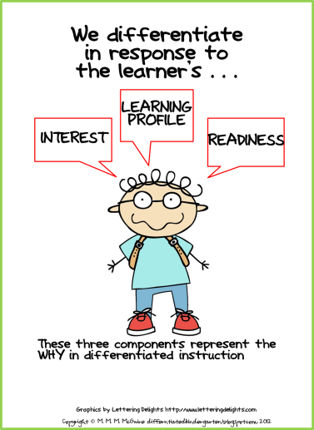
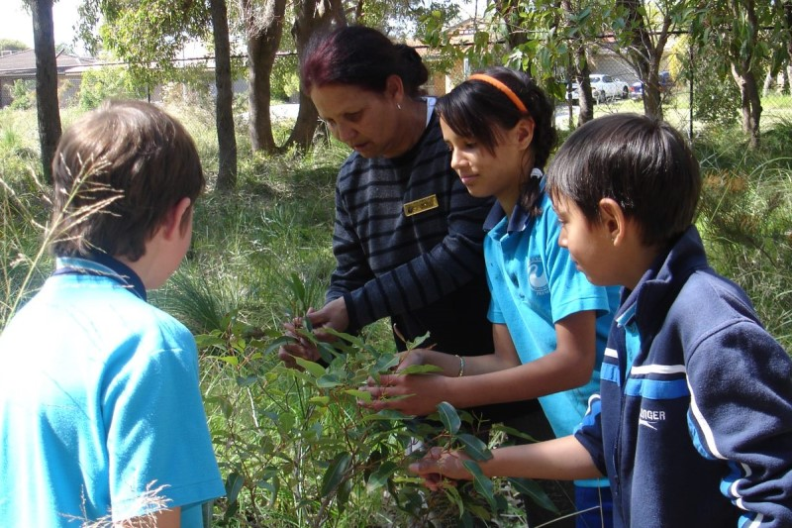
Inclusivity and Accessibility
Broad and Balanced Program
Engaging and Responding to Student Voice
Diverse Assessment Methods
Incorporating Indigenous Perspectives
Critical Discussion on Exclusion
Professional Development Opportunities
Notes:
Here are some practical examples and strategies:
Broad and Balanced Program: Going beyond traditional sports, PE programs can include a range of activities like rhythmic and expressive movements, lifelong fitness practices, and adventure activities. This approach ensures more students can find activities they enjoy and succeed in​​.
Engaging and Responding to Student Voice: Allowing students to have a say in their learning process can significantly increase their engagement. For example, students could choose from various physical activities to develop fitness plans or even teach peers a skill or concept. This approach empowers students by valuing their choices and perspectives​​.
Diverse Assessment Methods: Using various assessment methods, such as role plays, presentations, or animations, accommodates different learning styles and abilities. This flexibility ensures that assessments in PE are more inclusive and representative of each student's capabilities.
Incorporating Indigenous Perspectives: Including Aboriginal and Torres Strait Islander histories and cultures in PE programs, with appropriate permission and respect, enriches the curriculum. This might involve acknowledging the country, using Indigenous language terms, and teaching traditional games, promoting cultural awareness and respect​​.
Critical Discussion on Exclusion: PE provides an excellent context to discuss and challenge discrimination and exclusion. This involves examining problematic terminology and practices in sports and physical education and fostering an environment that values diversity and inclusivity​​.
Professional Development Opportunities: Teachers can enhance their ability to promote inclusion by participating in professional development programs. Organizations like Special Olympics Australia offer training focused on including students with disabilities. Other organizations provide guidance on engaging with broader aspects of diversity​​. https://www.specialolympics.com.au/Stories/special-olympics-launch-inclusive-sport-academy
https://www.teachermagazine.com/au_en/articles/strategies-to-promote-inclusion-in-health-and-physical-education-and-beyond

Slide 19
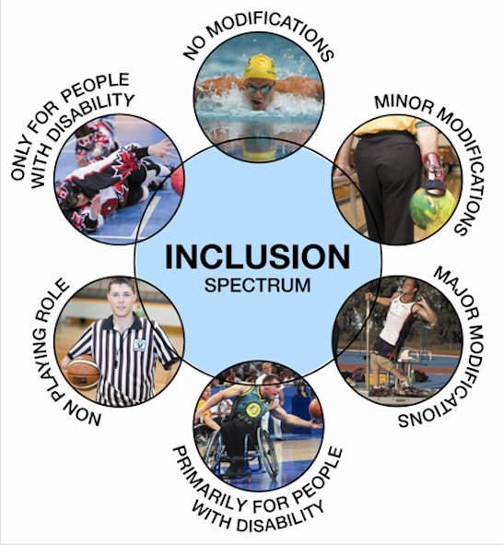
Inclusivity and Accessibility
Using the 7 Pillars of Inclusion Framework:
Access
Attitudes
Choice
Partnerships
Communication
Policy
Opportunity
Notes:
Using the 7 Pillars of Inclusion Framework: This framework helps audit and guide inclusive practices in PE. It includes pillars like access, attitude, choice, partnerships, communication, policy, and opportunities, helping educators create an environment where all students feel welcome and can participate effectively​​.
Access – access explores the importance of welcoming environment and the habits that create it.
Attitude – attitude looks at how willing people embrace inclusion and diversity and to take meaningful action.
Choice – choice is all about finding out what options people want and how they want to get involved.
Partnership – partnerships looks at how individual and organizational relationships are formed and how effective they are. Communication
Communication - Communication examines the way we let people know about the options to get involved and about the culture.
Policy - policy considers how an organization commits to and takes responsibility for inclusion.
Opportunities - opportunity explores what options are available for people from disadvantaged backgrounds.

Slide 20
Index
Introduction: The Evolution of Education and Physical Education
Current Issues in Physical Education
Integrating Technology
Inclusivity and Accessibility
Budget Constraints and Resource Limitations
Remote Learning Challenges
Promoting Mental Health
Creating indoor and outdoor affordances
Conclusions

Slide 21
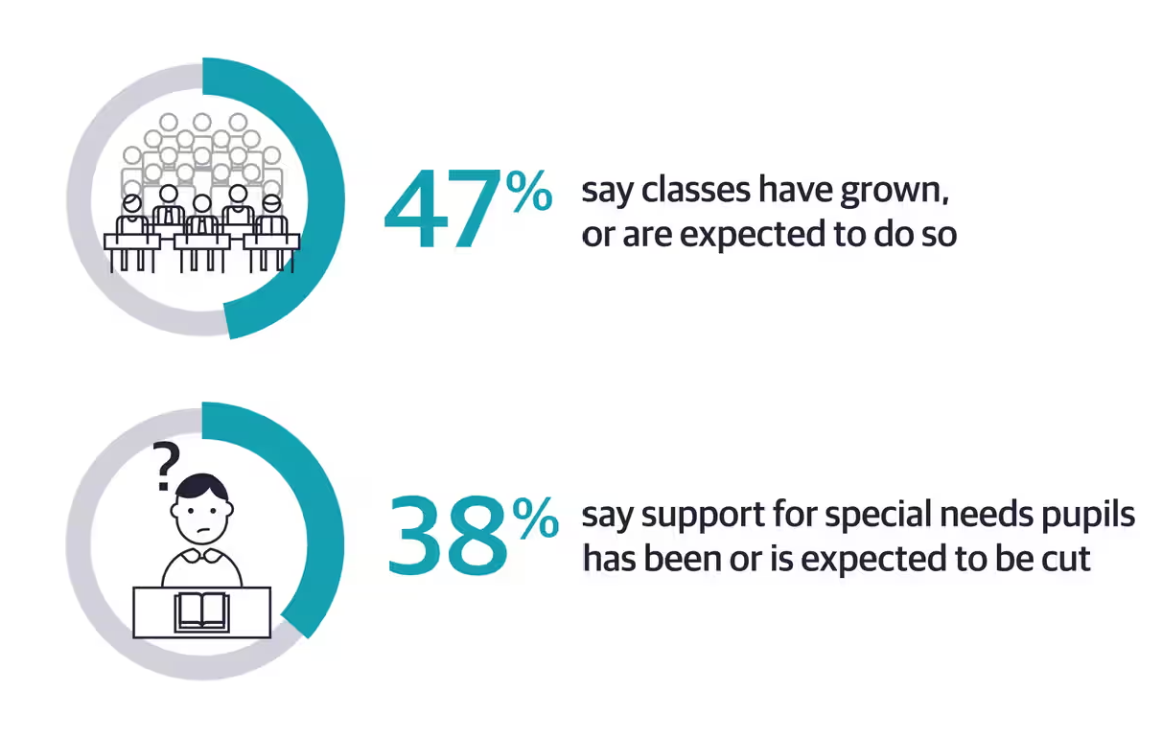
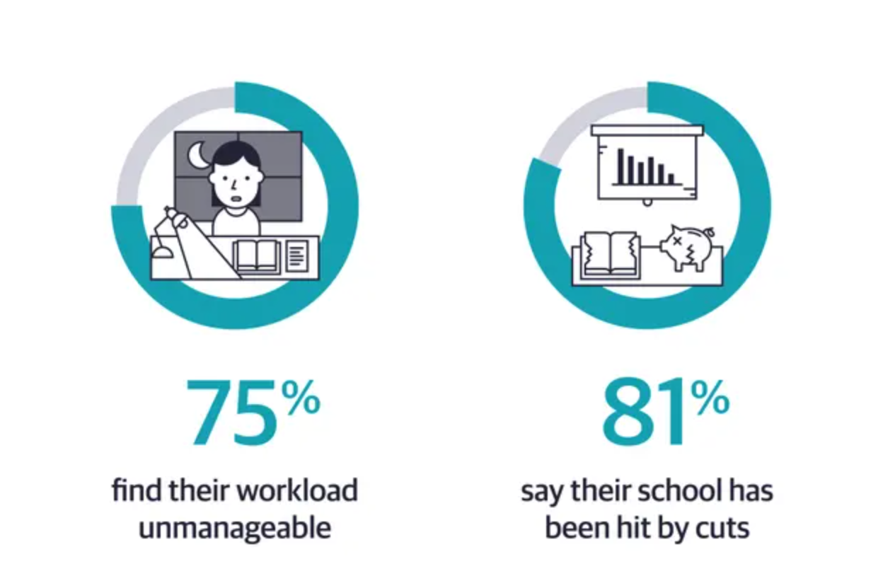
Budget Cuts and Resource Limitations
Problems: Many schools face budget cuts that impact PE, leading to larger class sizes, less equipment, and reduced program variety.
Rising Health Concerns: The lack of sufficient physical education in schools is contributing to the growing epidemic of obesity and related health issues among students. Physical activity is crucial for children's physical and mental development. The Center for Disease Control (CDC) recommends that children aged 5-17 get at least 60 minutes of moderate to vigorous physical activity daily. The absence of structured physical education can lead to mental and physical health issues, including heart disease, diabetes, depression, and obesity.
Long-Term Economic Impact: While budget cuts in physical education might appear to save money in the short term, they can lead to higher healthcare costs in the long run. The United States spends $147 billion annually on obesity-related healthcare costs​​. Thus, cutting PE funding is economically shortsighted, as it contributes to higher future health expenditures.
Notes:
Budget cuts and resource limitations have a significant impact on physical education (PE) programs in schools, leading to a range of issues that can affect students' health and well-being. The implications of these cuts are far-reaching and multifaceted:

Slide 22
Budget Cuts and Resource Limitations
Mental Health and Academic Performance: Regular physical activity is known to improve mental health and academic performance. Exercise releases endorphins, which help maintain a positive mood and reduce the risk of depression and suicide in children and young adults. The mental health benefits of exercise are particularly important, given the increasing rates of depression and anxiety among young people.
Impact on Teaching Quality: When PE programs are cut, the burden of providing exercise instruction often falls on classroom teachers, who may lack training in exercise science. This not only diminishes the quality of physical education but also adds to the workload of classroom teachers, potentially affecting the overall quality of education.
Skill Development and Early Intervention: PE teachers, with their specialized training in exercise physiology, kinesiology, and biomechanics, play a crucial role in developing students' motor skills and identifying developmental delays. Their expertise is essential for early intervention in physical development issues, which can be crucial for a child's overall well-being.
Policy Decisions and Funding Allocation: The decision to cut funding for PE often stems from policy decisions that prioritize other areas of education or seek to reduce overall educational expenses. For instance, in North Carolina, budget provisions require reduced class sizes without additional resources, leading to cuts in "enhancement" programs like PE.
Notes:
Budget cuts and resource limitations have a significant impact on physical education (PE) programs in schools, leading to a range of issues that can affect students' health and well-being. The implications of these cuts are far-reaching and multifaceted:
budget cuts and resource limitations in physical education not only undermine the physical and mental health of students but also have broader societal and economic repercussions. The reduction in quality and availability of PE programs can lead to increased healthcare costs and a decline in overall student well-being and academic performance. This highlights the need for policymakers and educational administrators to reconsider the allocation of resources and prioritize physical education as an integral part of the educational curriculum.

Slide 23
Index
Introduction: The Evolution of Education and Physical Education
Current Issues in Physical Education
Integrating Technology
Inclusivity and Accessibility
Budget Constraints and Resource Limitations
Remote Learning Challenges
Promoting Mental Health
Creating indoor and outdoor affordances
Conclusions

Slide 24
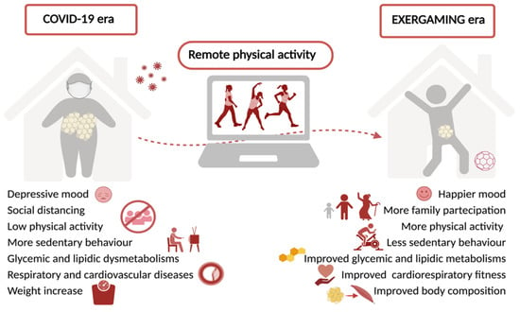
Challenges in Remote Learning for Physical Education
Decreased Physical Activity and Health Outcomes
Adapting to Technology
Student Engagement and Participation
Meeting the Needs of All Students
Professional Development (PD) Needs
Lack of PE-Specific PD
Notes:
Decreased Physical Activity and Health Outcomes: The pandemic-induced shift to online learning led to decreased levels of children’s physical activity and increased rates of obesity. This situation highlighted the critical role of PE in addressing public health concerns, including physical inactivity resulting from the pandemic.
Adapting to Technology: Many PE teachers faced the challenge of learning and adapting to new technology with little prior experience or training. They had to use trial-and-error methods, often resorting to platforms like Zoom, Flipgrid, Google Classroom, and YouTube to engage students. This adaptation was a significant hurdle, but many teachers successfully overcame it.
3. Student Engagement and Participation: Engaging students in an online environment proved to be a major challenge. Teachers reported difficulties in ensuring students were engaging with their lessons and completing assignments, particularly since PE was often not graded in a traditional sense during remote learning. The lack of clear school, district, or state-level policies made student accountability and participation challenging.
4. Meeting the Needs of All Students: Teachers struggled to reach all students, especially those without internet access. Some tried to overcome this by distributing printed activity sheets, but this led to further barriers in tracking student participation and engagement.
5. Professional Development (PD) Needs: Teachers expressed a need for additional PD, especially concerning technology issues and resources for teaching in socially distanced or at-home environments. They sought platform-specific training and guidance on creating online content.
6. Lack of PE-Specific PD: PE teachers often did not receive the same access to content-specific PD as their classroom teacher peers, leaving them to adapt to online teaching with limited support.

Slide 25
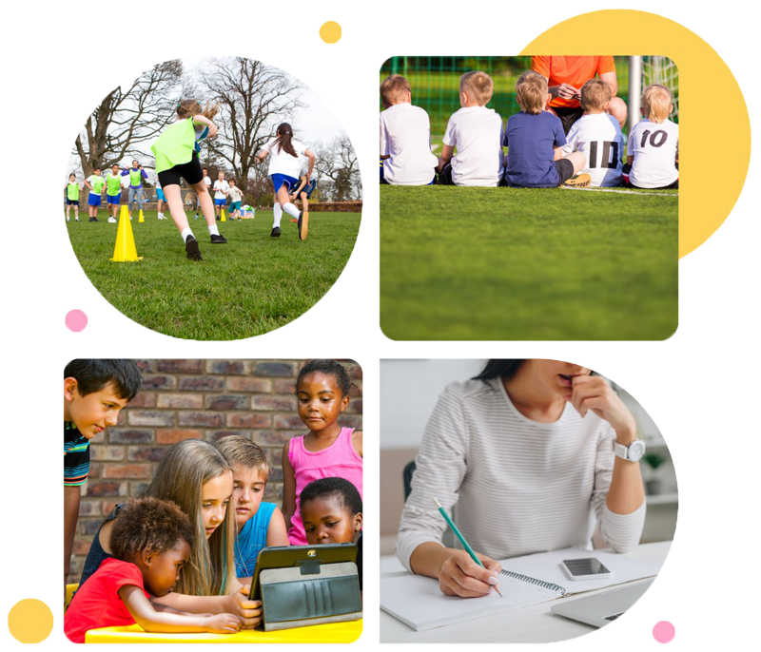
Practical Examples and Adaptations
Redefining Lesson Plans
Using Household Items
Social Media Engagement
Blended Learning Approaches
Notes:
Practical Examples and Adaptations:
Redefining Lesson Plans: PE teachers had to change their lesson plans significantly, focusing on keeping students active and happy during brief movement periods. The time allocated for PE was reduced as schools tried to balance the rest of the school day online​​.
Using Household Items: Teachers creatively used household items for physical activities. For example, students played golf with laundry baskets and rolled-up socks and built towers out of shoes for physical challenges​​.
Social Media Engagement: Some teachers embraced social media platforms like TikTok to create engaging daily workouts and encourage student participation​​.
Blended Learning Approaches: PE classes became a mix of live virtual teaching, pre-recorded classes, and socially distant in-person lessons, each tailored to meet state education standards and adapt to the limitations of remote learning​​.
These challenges and adaptations underscore the importance of PE in promoting students' physical and mental health, especially in remote learning environments. The experience of teaching PE remotely during the pandemic has provided valuable insights into how PE can be effectively delivered in future online or blended learning scenarios.

Slide 26
Promoting Mental Health
Sound Body Sound Mind Program
Social-Emotional Learning in PE
Emotional Check-ins in PE
Individualized Exercise Plans for Students with Disabilities
Enhancing Accessibility in Underserved Communities
Notes:
Promoting mental health in physical education (PE) classes involves innovative strategies that not only focus on physical activity but also on social-emotional learning and overall well-being. Here are some practical examples and insights:
Sound Body Sound Mind Program: This program provides state-of-the-art fitness equipment and resources to middle and high schools, supporting a holistic approach to health and wellness. It continued to assist families and communities during the pandemic, ensuring students could incorporate movement into their daily academic programs despite distanced learning​​.
Social-Emotional Learning in PE: Physical education classes play a key role in developing social-emotional skills. Research shows that exercise improves school performance and children have an easier time focusing and learning after they have exercised​​.
Emotional Check-ins in PE: SHAPE America suggests including an emotional check-in at the beginning of PE classes, where students select an emoji to represent their feelings. This practice often results in students choosing a more positive emoji at the end of the class, reflecting the mood-enhancing effects of physical activity​​.
Individualized Exercise Plans for Students with Disabilities: For children exempt from PE due to health conditions, schools can provide individualized exercise plans or adaptive PE programs. This ensures that all students, regardless of their physical abilities, can benefit from physical activity and its mental health benefits​​.
Enhancing Accessibility in Underserved Communities: Programs like UCLA Sound Body Sound Mind work to provide resources and safe environments for exercise, particularly in underserved communities. This ensures that all children, regardless of their background, have access to the mental health benefits of physical activity

Slide 27
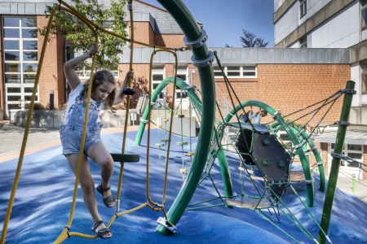
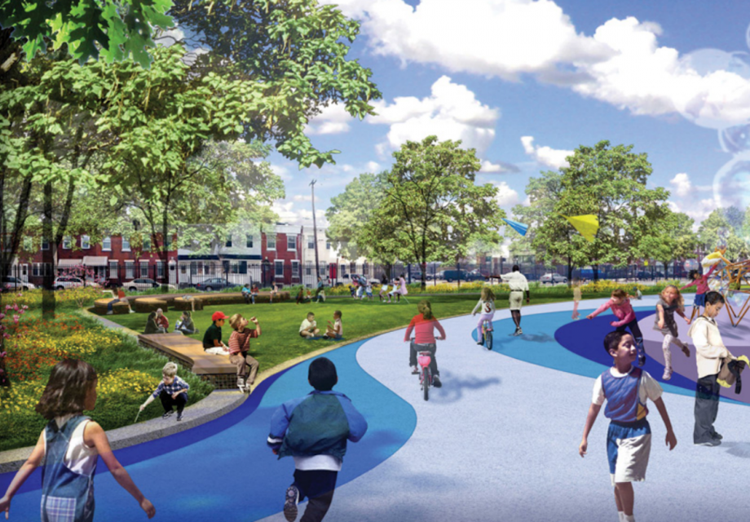
The school yard as an arena for increasing student physical activity
Central Role of Schools: Schools are pivotal in promoting physical activity, offering a range of opportunities like physical education, active breaks, school trips, and recess activities.
Significant Impact on Daily Activity: Activities during school, particularly during breaks, can contribute substantially (5% to 40%) to the recommended daily physical activity for young people.
Factors Affecting Activity Levels: Physical activity during recess is influenced by the schoolyard size, student age and gender, and ethnic differences.
Benefits of Outdoor Lessons: Outdoor lessons in schoolyards have been shown to significantly increase students' physical activity levels.
Guidelines from Finnish Program: The "Finish School on the Move" program in Finland emphasizes reducing sitting time, increasing movement, involving students in planning activities, and enhancing learning through physical activity.
Notes:
Mokykla yra aplinka, kurioje vaikai praleidžia didžiąją laiko dalį, ir yra dažniausiai naudojama jaunimo fizinio aktyvumo skatinimo aplinka (van Sluijs ir kt., 2007). Mokyklinės dienos gali pasiūlyti įvairias aktyvumo galimybes, pavyzdžiui, fizinio ugdymo pamokos, aktyvios pertraukėlės pamokų metu, aktyvus vykimas į mokyklą ir fizinė veikla pertraukos metu (Haug et al., 2008; Haug et al., 2010).
Ankstesni tyrimai parodė, kad pertraukų metu galima pasiekti nuo 5 proc. iki 40 proc. rekomenduojamo kasdienio fizinio aktyvumo (Ridgers ir kt., 2006). Fiziniam aktyvumui pertraukos metu įtakos turi mokyklos kiemo dydis (Escalante et al., 2012; Escalante et al., 2014b), amžius ir lytis (Escalante et al., 2014a) ir etninės priklausomybės skirtumai (Blatchford et al. 2003).
Be to, pamokos lauke, organizuojamos mokyklos kiemuose, galėtų žymiai padidinti mokinio fizinio aktyvumo lygį (Mygind, 2007). Pagal Suomijos vykdomą „Finish School on the Move“ programą (Haapala, 2017), kiekviena mokykla turėtų siekti:
• sutrumpinti sėdėjimo laiką mokyklinės dienos eigoje;
• pridėti daugiau judesio ir sutrumpinti sėdėjimo laiką mokyklos dienos bėgyje,
• didinti mokinių dalyvavimą planuojant fizinę veiklą mokyklos dieną,
• pagerinti mokymąsi atliekant fizinę veiklą.

Slide 28
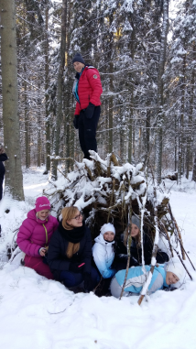
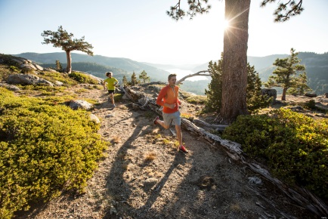
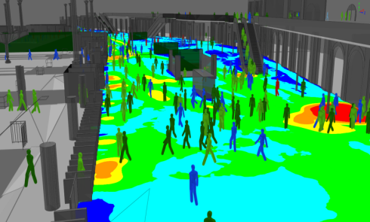
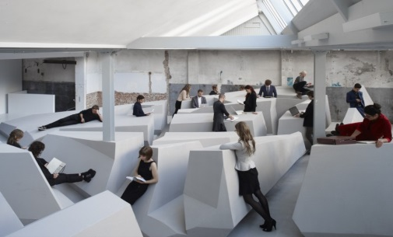
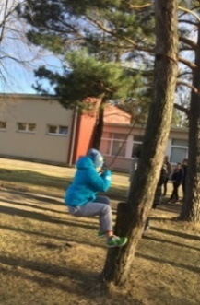
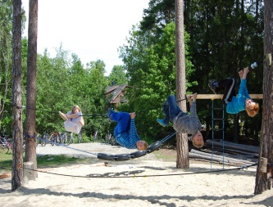
Nordic Baltic Learning Environments for Movement Affordances NPHZ-2017/10130
The aim of this project was to share the good experience of the North-Baltic countries on how the learning environment is adapted to the promotion of physical activity among students.
During the project, an assessment of school environments was carried out, recommendations and requirements for schoolyards existing in various countries were compared. Recommendations for local municipalities, ministries and the school community were prepared on the basis of the received analysis.
28
Notes:
.

Slide 29
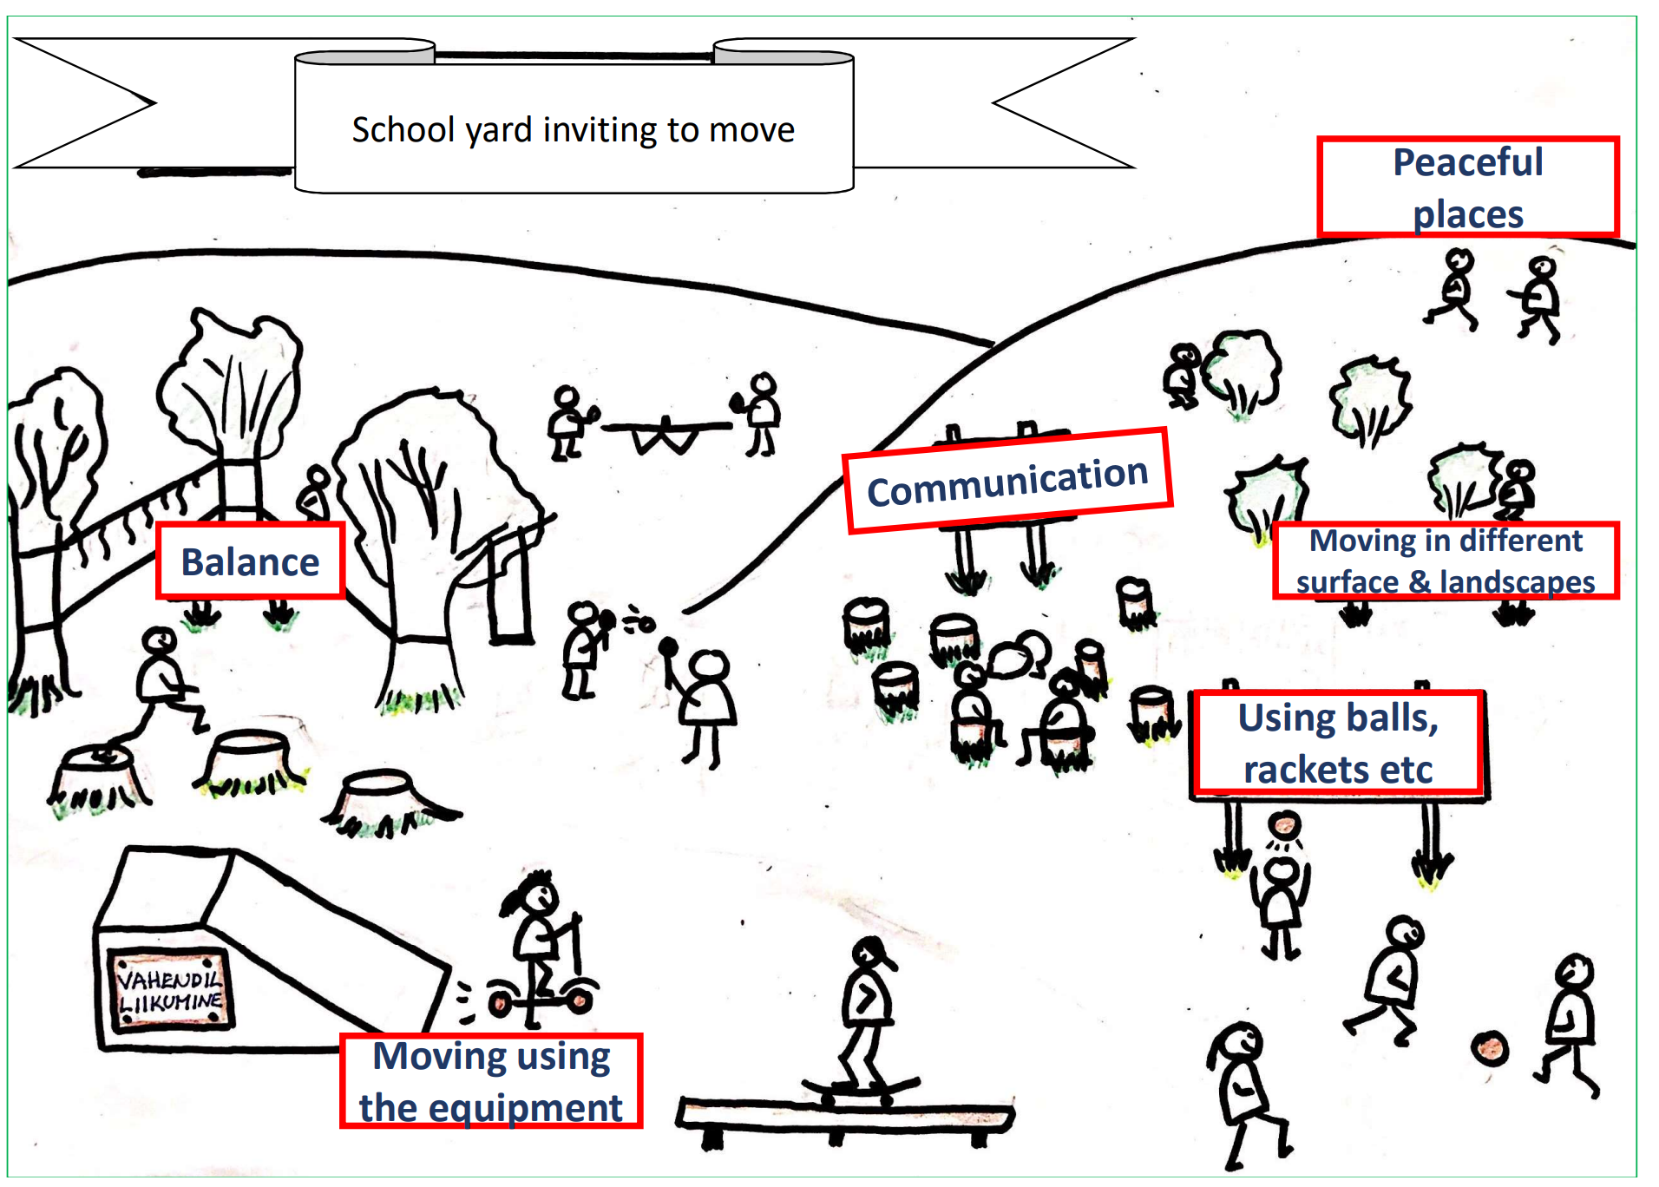
Notes:
The schoolyard, as an arena for the development of movement skills, should include elements and areas that support the development of basic movement skills:
locomotor movement skills: running in different directions and on different surfaces (for example, up and down a hill, between trees and bushes), walking, jumping and climbing, rolling, crawling, balancing, etc.
locomotor movement skills with equipment: for example, riding a bicycle, scooter, skateboard, cross-country skiing, ice skating, etc.
manipulative skills: spaces for different games with different objects or equipment (e.g. rackets, soccer ball, basketball, lacrosse plate, etc.).
body control and stability skills: objects in which it is possible to maintain static (stump, etc.) and dynamic balance (boom, etc.) and transfer weight (swing).
In addition, through different physical capabilities, students' physical fitness components will develop speed, agility, strength, endurance, coordination, and more.

Slide 30
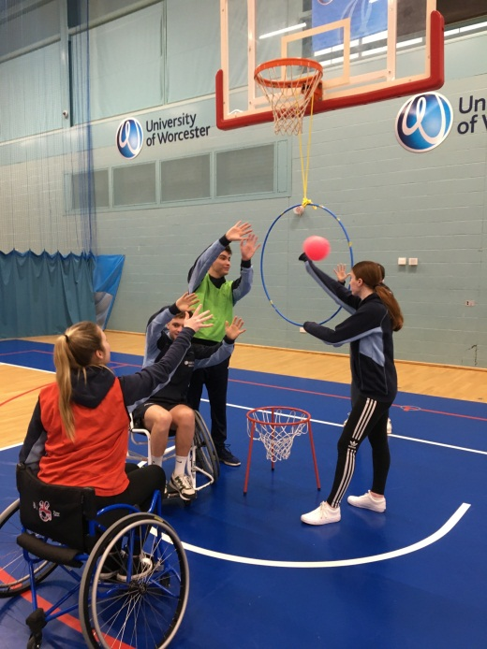
Conclusions
Notes:
In summary, while physical education faces numerous challenges, from inclusivity and budget constraints to the integration of technology and mental health, the future is bright with possibilities. Let us advocate for robust, inclusive, and technologically advanced PE programs. Together, we can ensure that physical education remains a dynamic and integral part of our educational system. Physical education today might have more challenges than a tough game of Twister, but the opportunities are just as flexible and exciting. Let's step up to the plate, or the yoga mat, and advocate for a future where PE is as dynamic and inclusive as a well-choreographed flash mob. Thank you, and let's keep the ball rolling with any questions or discussions!"

